Slide 1
Application of Intelligent Recommendation for Agricultural cultivation.

Slide 2
Abstract
Farmers face several challenges when growing cropslike uncertain irrigation, poor soil quality, etc. Especially in India,a major fraction of farmers do not have the knowledge to selectappropriate crops and fertilizers. Moreover, crop failure due todisease causes a significant loss to the farmers, as well as theconsumers. While there have been recent developments in theautomated detection of these diseases using Machine Learningtechniques, the utilization of Deep Learning has not been fullyexplored. Additionally, such models are not easy to use because ofthe high-quality data used in their training, lack of computationalpower, and poor generalizability of the models. To this end, wecreate an open-source easy-to-use web application to addresssome of these issues which may help improve crop production.In particular, we support crop recommendation, fertilizer recommendation and plant disease prediction .In addition, we also use interpretability techniques in an attemptto explain the prediction made by our disease detection model

Slide 3
INTRODUCTION
Agriculture is an extremely risky industry and our farmersare at the forefront of the industry. Farmers face severalproblems which include crops get affected by diseases, thesoil is not being nutritious enough for the plant to grow, etc.All these factors reduce the overall yield. In India, more than70% population is dependent on agriculture . More than15% of the crops get wasted in India due to diseases andhence it has become one of the major concerns to be resolved
The three macro-nutrients used by plants are nitrogen,Phosphorus, and Potassium. N is responsible for the growthof leaves in a plant, P for root, flower and fruit, and K helpsthe overall function of the plant. Knowing the NPK values offertilizer can help a farmer select a fertilizer that is appropriatefor the type of plant they are growing.

Slide 4
objective:
Farming is one of the major sectors that influences a country’s economic growth.
In country like India, majority of the population is dependent on agriculture for their livelihood. Many new technologies, such as Machine Learning and Deep Learning, are being implemented into agriculture so that it is easier for farmers to grow and maximize their yield.

Slide 5
novelty
AI systems are helping to improve the overall harvest quality and accuracy – known as precision agriculture. AI technology helps in detecting disease in plants, pests and poor nutrition of farms. AI sensors can detect and target weeds and then decide which herbicide to apply within the region

Slide 6
PROPOSED SYSTEM
In our project, I present a website in which the following applications are implemented; Crop recommendation, Fertilizer recommendation and Plant disease prediction, respectively.
In the crop recommendation application, the user can provide the soil data from their side and the application will predict which crop should the user grow.
For the fertilizer recommendation application, the user can input the soil data and the type of crop they are growing, and the application will predict what the soil lacks or has excess of and will recommend improvements.
For the last application, that is the plant disease prediction application, the user can input an image of a diseased plant leaf, and the application will predict what disease it is and will also give a little background about the disease and suggestions to cure it.

Slide 7
Advantage:
ML and DL systems are helping to improve the overall harvest quality and accuracy – known as precision agriculture.
this technology helps in detecting disease in plants, pests and poor nutrition of farms.
sensors can detect and target weeds and then decide which herbicide to apply within the region.

Slide 8
literature survey
Title: Crop Suitability and Fertilizers RecommendationUsing Data Mining Techniques
Author: Archana Chougule, Vijay Kumar Jha and DebajyotiMukhopadhyay
Method Used: Random Forest, K- means clusteringalgorithm
Remark: Accuracy of random forest is found to be higherthan ID3(Iterative Dichotomiser 3) algorithm for cropprediction and K- means for fertilizer recommendation

Slide 9
literature survey
Title: Random Forest Algorithm for Soil Fertility Predictionand Grading Using Machine Learning
Author: Keerthan Kumar T G, Shubha C, Sushma S AMethod Used: Random Forest, Gaussian Naïve Bayes,Support Vector Machine, Linear Regression
Remark: In case of Crop Prediction, Random Forest provesto be a better classifier as compared to Gaussian Naïve Bayesand Support Vector Machine while linear regression worksefficiently for grading soil.

Slide 10
literature survey
Title: Soil Classification using Machine Learning Methodsand Crop Suggestion Based on soil series
Author: Sk Al Zaminur Rahman, S.M. Mohidul Islam, KaushikChandra Mitra
Method Used: Weighted K-NN, SVM, Bagged TreeRemark: SVM has given the highest accuracy in soilclassification as compared to K-NN and Bagged treealgorithms.

Slide 11
literature survey
Title: AgroConsultant: Intelligent Crop RecommendationSystem Using Machine Learning Algorithms
Author: Zeel Doshi, Subhash Nadkarni, Rashi Agrawal, Prof.Neepa Shah
Method Used: Decision Tree, Random Forest, K- NNRemark: Accuracy rates were Decision Tree (90.20), KNN (89.78), Random Forest (90.43)

Slide 12
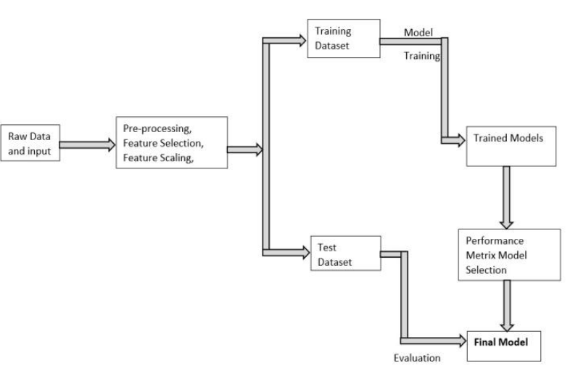
Block Diagram:

Slide 13
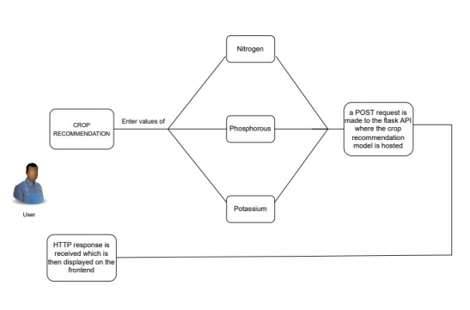
FLOW DIAGRAM FOR CROP

Slide 14
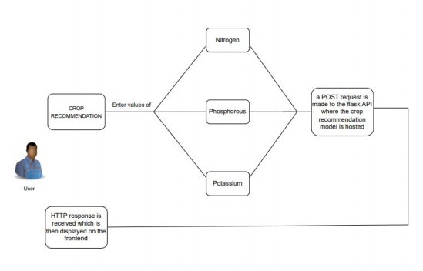
FLOW DIAGRAM FOR FETILIZER

Slide 15
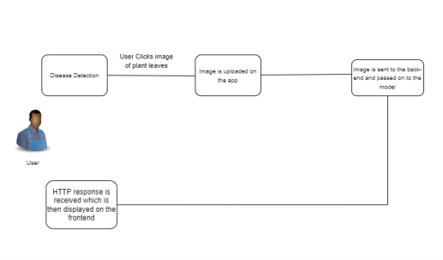
FLOW DIAGRAM FOR PLANT DISEASE DETECTION

Slide 16
METHODOLAGY
Crop Recommendation
In the authors use - Random forests, Artificial NeuralNets, Support Vector Machines, etc. and conclude that Randomforests work best for their dataset in crop recommendation.They also create a mobile application system which takes in location data using GPS and predicts the crop yield for a givencrop, in addition to recommending crops based on area andsoil quality as input. RandomTrees for crop recommendation.
Fertilizer Recommendation
A lot of research has been done in fertilizer recommendationand a majority of them use the N, P, K, pH values ofsoil sometimes in addition with depth, temperature, weather,location, precipitation. The usual approach is to use rule basedclassification, but some approaches also use clusteringon fertilizer data using K-Means and Random Forests forrecommendation.

Slide 17
METHODOLAGY
Plant Disease Detection has been a very active field of research and there are several different techniques which have been proposed over the years, the latest ones using deep learning approaches.

Slide 18
. Dataset
The dataset for this topic was taken from Kaggle. It is acrop recommendation dataset giving us information abou tvarious types of crops and the features that decide which crop is suitable for growing
Features of the Dataset
N: ratio of Nitrogen content in soil
P: ratio of Phosphorous content in soil
K: ratio of Potassium content in soil
Temperature: temperature in degree Celsius
Humidity: relative humidity in %
pH: pH value of the soil
rainfall: rainfall in mm

Slide 19
MODULES:
DataSet
Data preprocessing.
Splitting dataset.
Build the model
Training the model.
Evaluating the model.
Testing the model
Saving the model.

Slide 20
CONCLUSION
we propose a user-friendly web applicationsystem based on machine learning and web-scraping calledthe ‘Farmer’s Assistant’. With our system, we are successfullyable to provide several features - crop recommendation using Random Forest algorithm, fertilizer recommendation using a rule based classification system, and crop disease detection using EfficientNet model on leaf images. The user can provide the input using forms on our user interface and quickly get their results. In addition, we also use the LIME interpretability method to explain our predictions on the disease detection image, which can potentially help understand why our model predicts what it predicts, and improve the datasets and models using this information

Slide 21
REFERENCES
S. D. Khirade, A. B. Patil, “Plant Disease Detection Using ImageProcessing”, 2015 International Conference on Computing Communi_x0002_cation Control and Automation, 2015, pp. 768-771, doi: 10.1109/IC_x0002_CUBEA.2015.153.
A. V. Panchal, S. C. Patel, K. Bagyalakshmi, P. Kumar, I. RazaKhan, M. Soni, “Image-based Plant Diseases Detection using Deep Learning”, Materials Today: Proceedings, 2021, ISSN 2214-7853, https://doi.org/10.1016/j.matpr.2021.07.281.
J. Deng, W. Dong, R. Socher, L. -J. Li, Kai Li and Li Fei-Fei, “ImageNet: A large-scale hierarchical image database”, 2009 IEEE Conference on Computer Vision and Pattern Recognition, 2009, pp. 248-255, doi: 10.1109/CVPR.2009.5206848.
Russakovsky et al., “ImageNet Large Scale Visual Recognition Chal_x0002_lenge”, International Journal of Computer Vision, 2015, 115(3), 211- 252. https://doi.org/10.1007/s11263-015-0816-y.
George A. Miller, “WordNet: A Lexical Database for English”, Com_x0002_munications of the ACM, 1995, Vol. 38, No. 11: 39-41.
A. Krizhevsky, I. Sutskever, G. E. Hinton, “ImageNet Classification with Deep Convolutional Neural Networks”, Part of Advances in Neural Information Processing Systems 25 (NIPS 2012)

